Slide 1

Testing Stuff With Chimp

Slide 2
What We’ll Cover
What is Chimp?
Why Chimp?
Demo
(lazy, I know)

Slide 3

What is Chimp
Automated Testing tool built with node.js
Write acceptance / end-to-end tests how you like
Mocha
Jasmine
Cucumber.js
Browser automation:
Selenium (including cloud based services)
WebdriverIO API

Slide 4
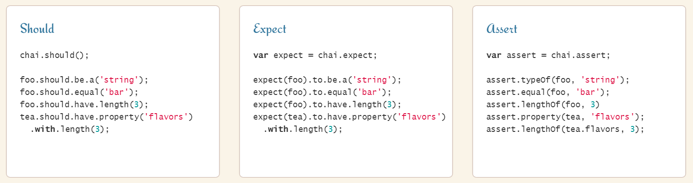
What is Chimp – Assertions
BDD/TDD assertions:
Chai
Jasmine

Slide 5
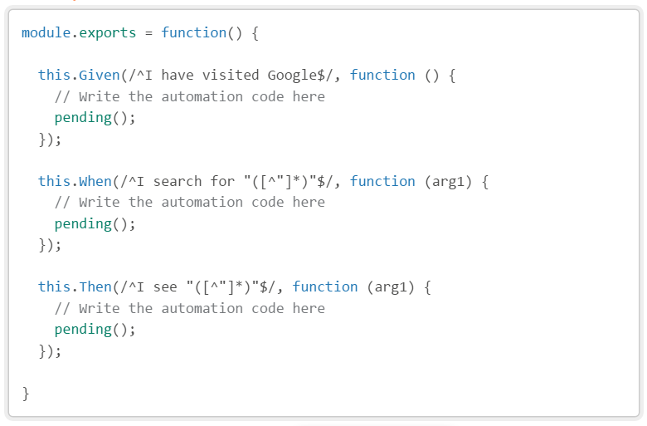
What is Chimp - JS
Write it in JavaScript

Slide 6
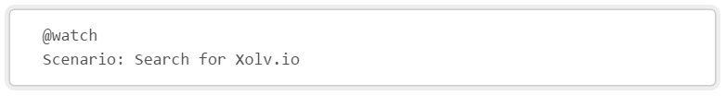
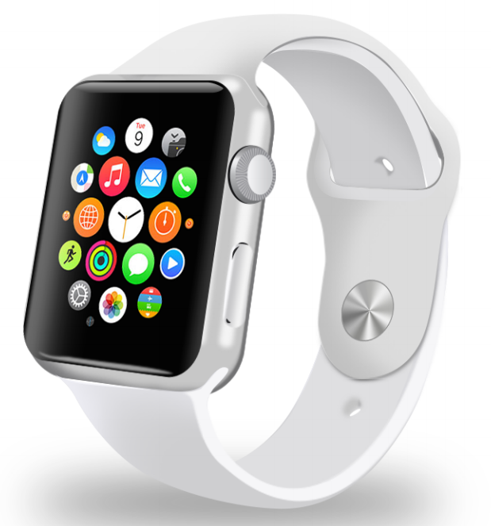
What is Chimp - Watch
Watch mode
Reruns only the specs you tag
Focus on the feature you're working on

Slide 7
What is Chimp - Bullet points
Browser Session Reuse
Downloads and Configures Dependencies
Selenium
ChromeDriver
IEDriver
PhantomJS
Multiplatform
Windows
OSX
Linux

Slide 8

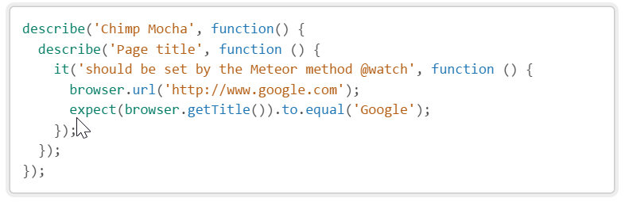
What is Chimp - Mocha
Mocha - develop
Mocha - test

Slide 9
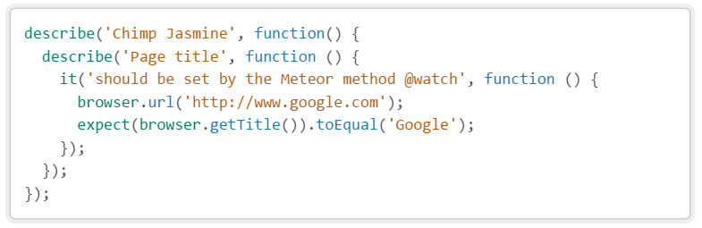
What is Chimp - Jasmine
Jasmine - develop
Jasmine - test

Slide 10
What is Chimp - Cucumber
Cucumber - develop

Slide 11
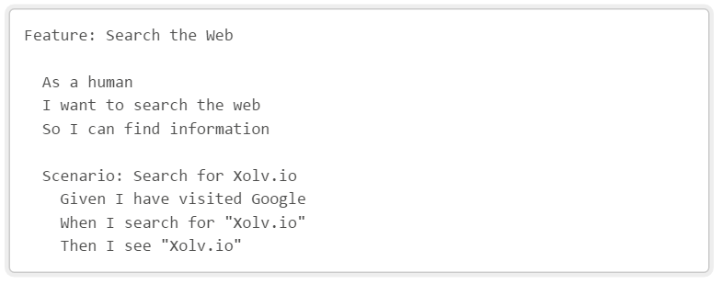
What is Chimp - Gherkin
Human readable feature files

Slide 12
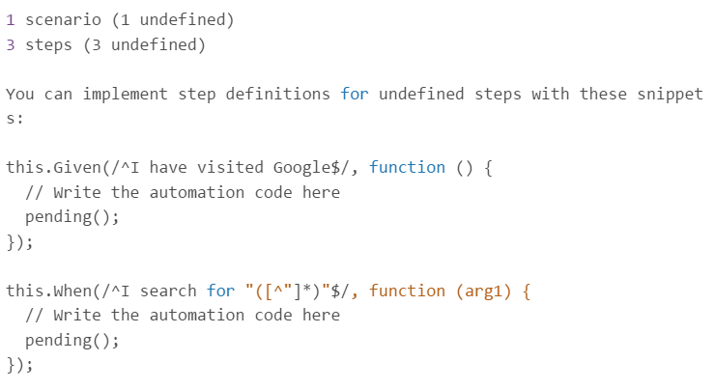
What is Chimp - Helping with stuff
Helps you write your unimplemented feature step definition files

Slide 13
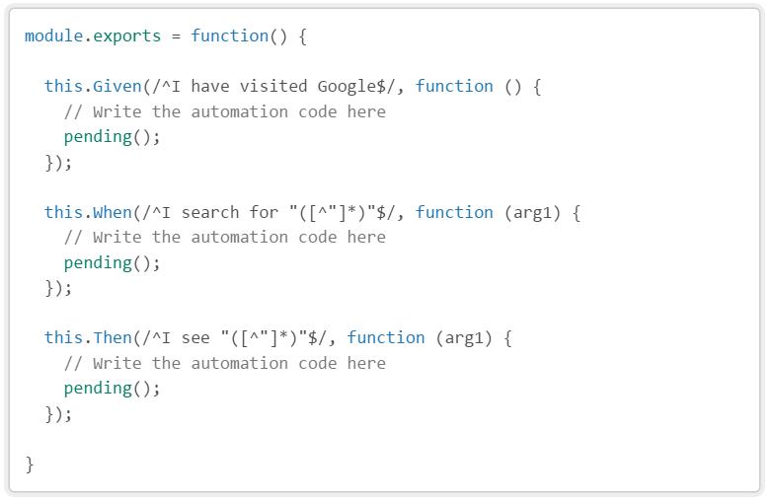
What is Chimp - Step Definitions
Here are the step definitions

Slide 14
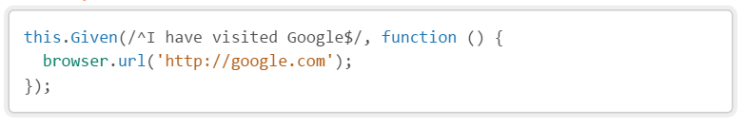
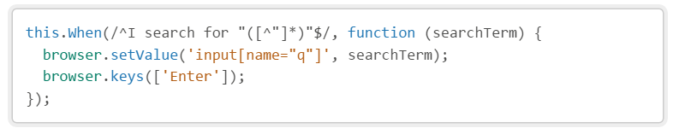
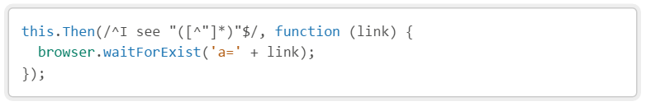
What is Chimp – WebdriverIO
Browser interactions using WebdriverIO

Slide 15
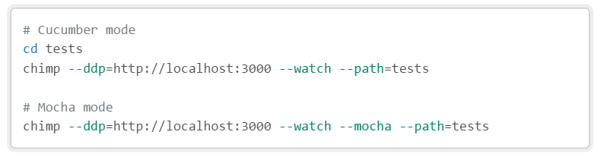
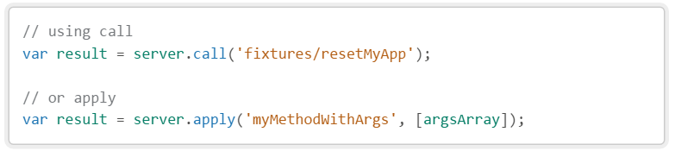
What is Chimp - Meteor
Meteor ddp connection
Meteor server calls

Slide 16
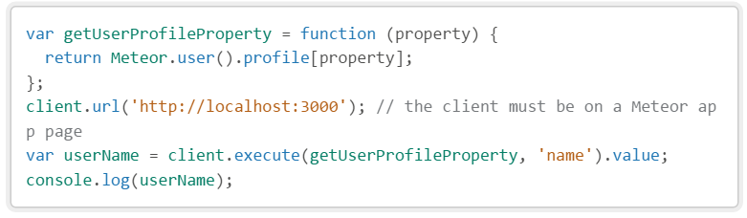
What is Chimp - Meteor
Meteor client calls

Slide 17
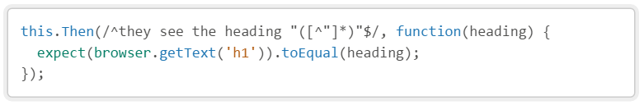
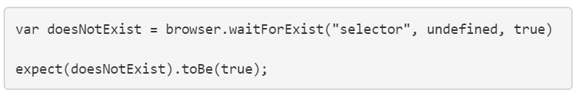
Why Chimp - Magic
Cucumber + Jasmine + WebdriverIO = clean automation steps

Slide 18
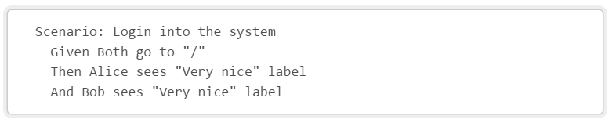
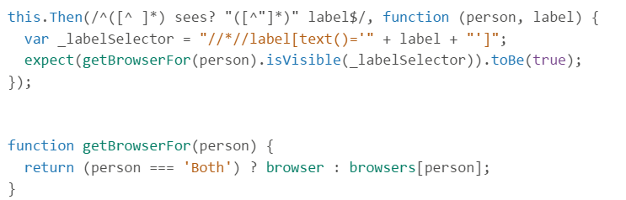
Why Chimp - Magic
Multi-browser

Slide 19
Learning Chimp
chimp.readme.io/docs
cucumber.io/docs/reference
jasmine.github.io
webdriver.io/api.html

Slide 20
Thank You!

Slide 21
Demo
Medtech

